Slide 1
Creating Dashboards with Python
More specifically – plotly & Dash
Summer 2023

Slide 2
Housekeeping
In case of technical problems:
Something wrong on my end (e.g. power outage), I will send you an email.
Something wrong on your end, please send me a text message. 508-769-6446
jcodygroup@gmail.com
We have 4 hours for each session
I will try to give you an opportunity to stand and stretch every hour.
We will take at least one 15-minute break near the halfway point.

Slide 3
About me
Experience:
25+ years consulting and training experience
Extensive work with “big data” and analytics
15 years working with various data visualization tools
Education
Ed. M., Technology, Innovation & Education, Harvard University
PhD Candidate, Education Policy, University of Massachusetts, Amherst

Slide 4

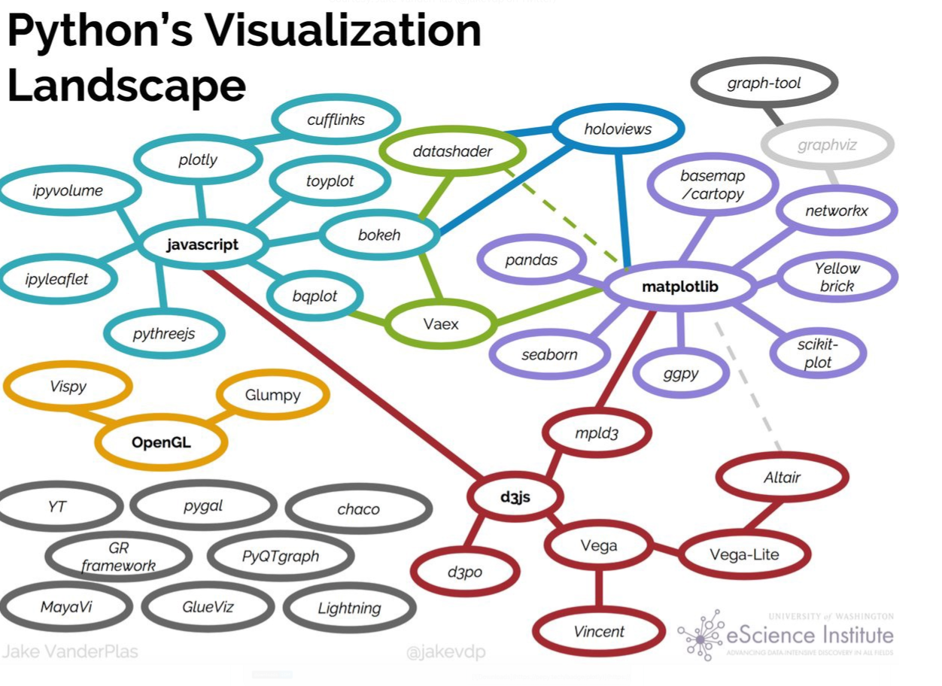




Slide 5
Visualization packages
Matplotlib
pyplot
seaborn
Plotly
express
Dashboard Options
Dash
Voila
Streamlit
Bokeh
Panel
quick &
easy
Matplotlib
Object-oriented
ggplot
Plotly
graph objects
Complex
& many
options
Altair
Built for interactivity

Slide 6
Our tasks
Plotly
Dash
Deploy to Web
Python
(notebooks
ipywidgets)
git
heroku
and through
kaggle

Slide 7
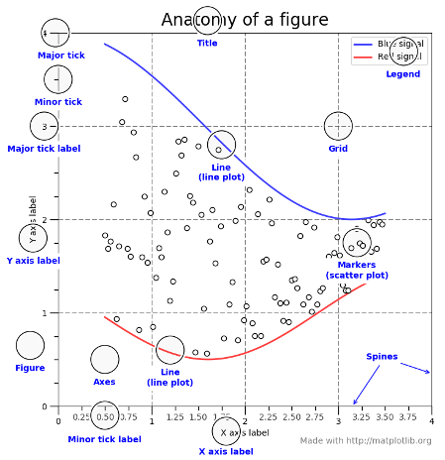
Anatomy of a figure
Matplotlib
pyplot
seaborn
quick &
easy
Matplotlib
Object-oriented
Complex
& many
options

Slide 8
Matplotlib/Seaborn: Two big concepts
Figure
Axes
Plot
Figure
Axes
Plot 1
Plot 2
Figure
Axes
Axes
Plot 1
Plot
Plot 2

Slide 9
Built for interactivity
Matplotlib
pyplot
seaborn
Plotly
express
Dashboard Options
Dash
Voila
Streamlit
Bokeh
Panel
quick &
easy
Matplotlib
Object-oriented
ggplot
Plotly
graph objects
Complex
& many
options
Altair
Built for interactivity

Slide 10
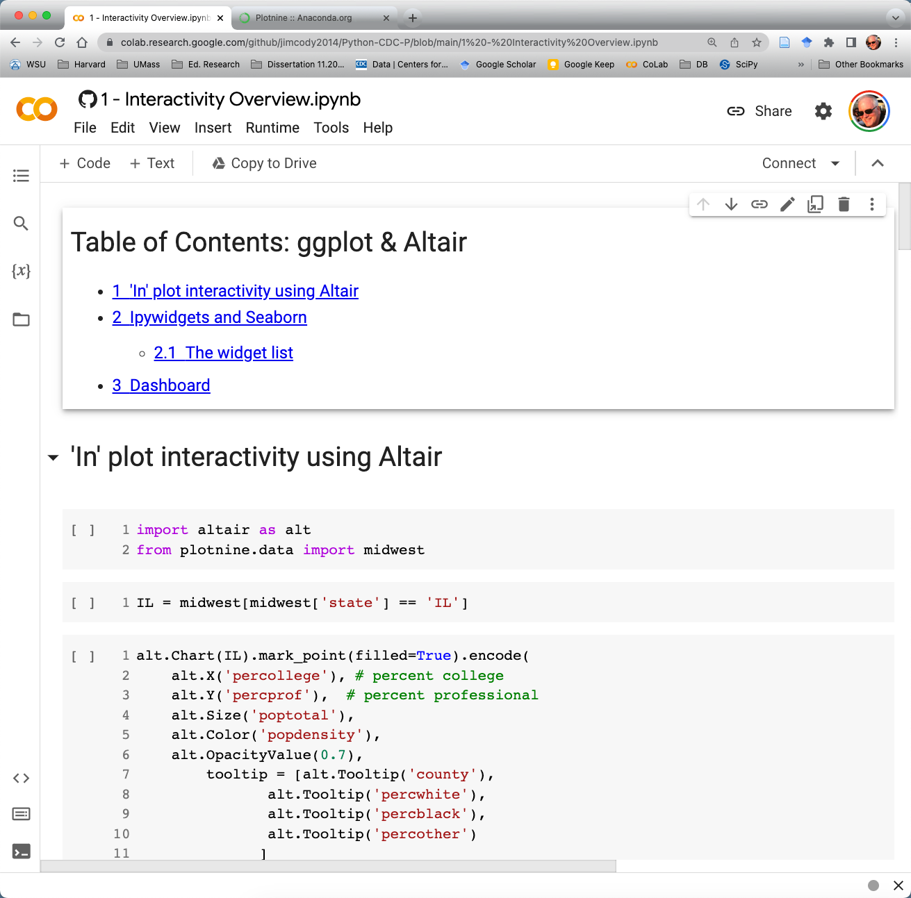
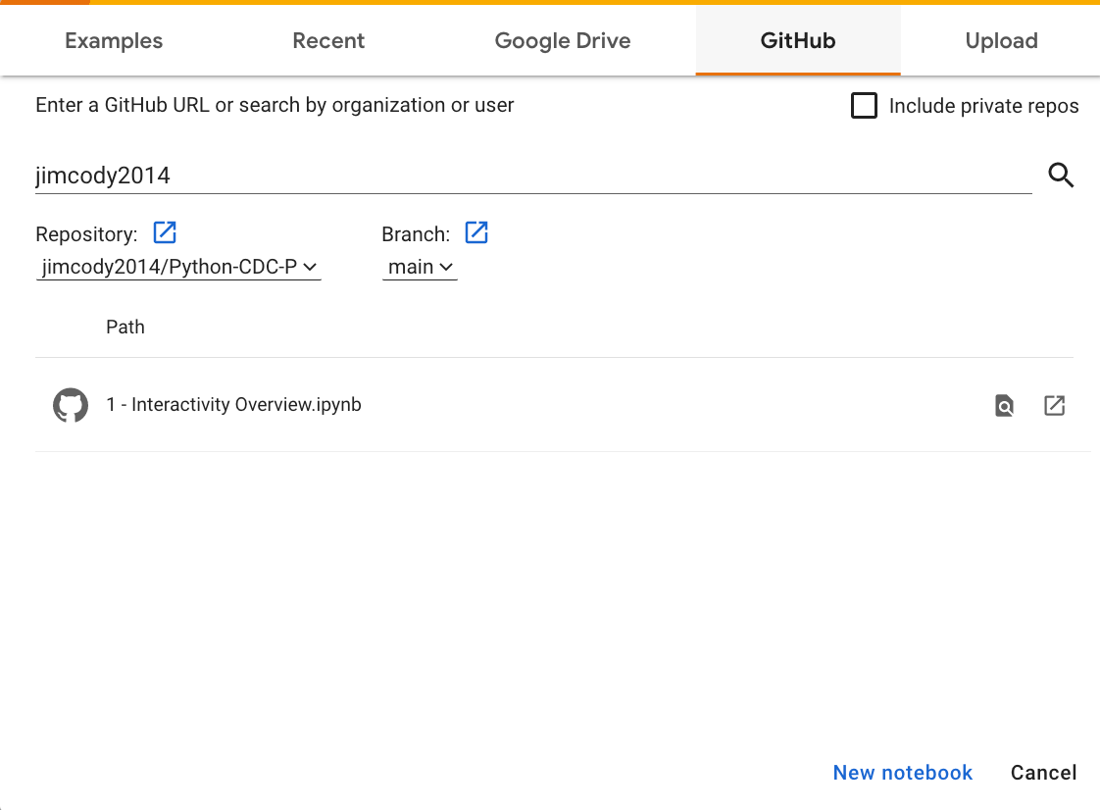
Interactivity notebook
Click there

Slide 11
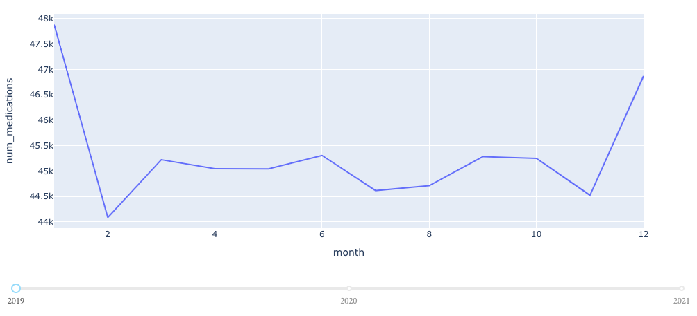
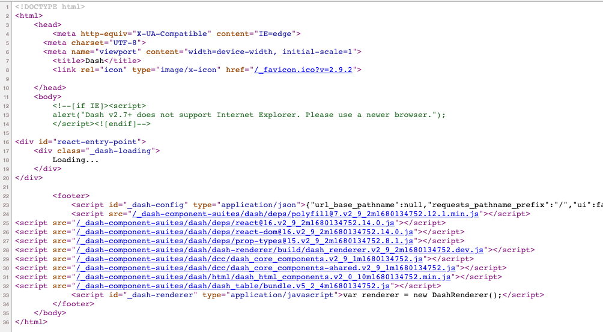
Web Pages: HTML tags, CSS & javascript

Slide 12
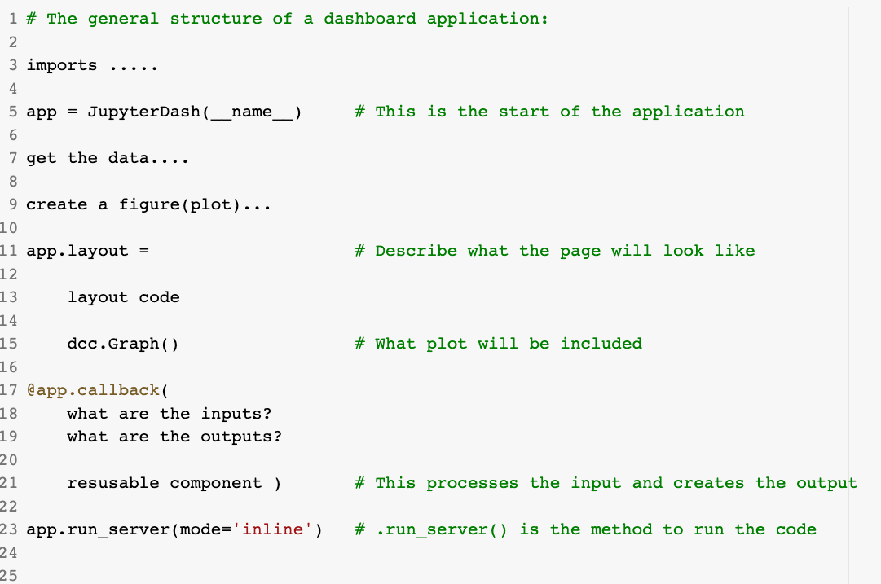
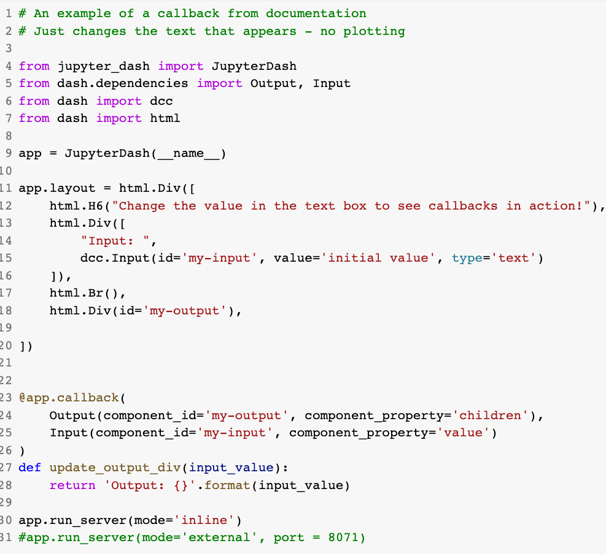
Dashboard Structure

Slide 13
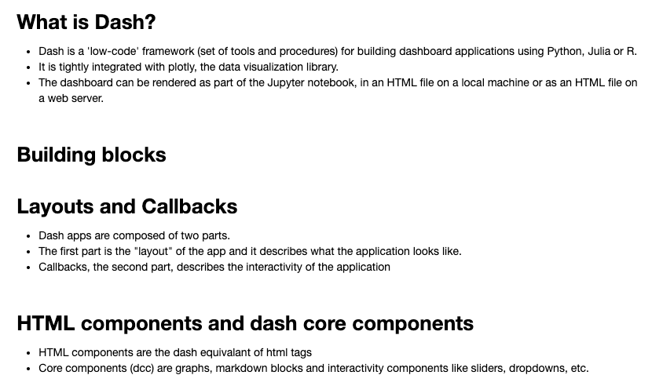
Notebook: 2 – Dash – Getting started
Click there

Slide 14
Our tasks
Dash
Introduction
Plotly express
Plotly
graph objects
Dash exploration
Dash
again
Deploy to Web
Terminology
Structure
CoLab
px.line
px.scatter
px.bar
facets
Figures
Layout
Traces
Data
Update layout
Hover text
Layout
Add a plot
Change plot
Html components
Component args.
Div()
Positioning
Repositioning
Markdown text
Interactivity comps
Callback
Reusable comp
Simple callback
Changing variables
Terminology
Structure
git & heroku

Slide 15
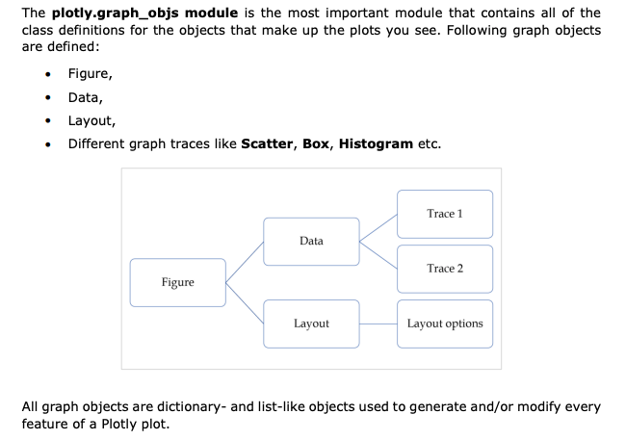
plotly graph objects

Slide 16
Day 1 Recap
Google CoLab
Virtual Environment
Virtual Environment
Working with CoLab
Python Basics
Google Drive

Slide 17
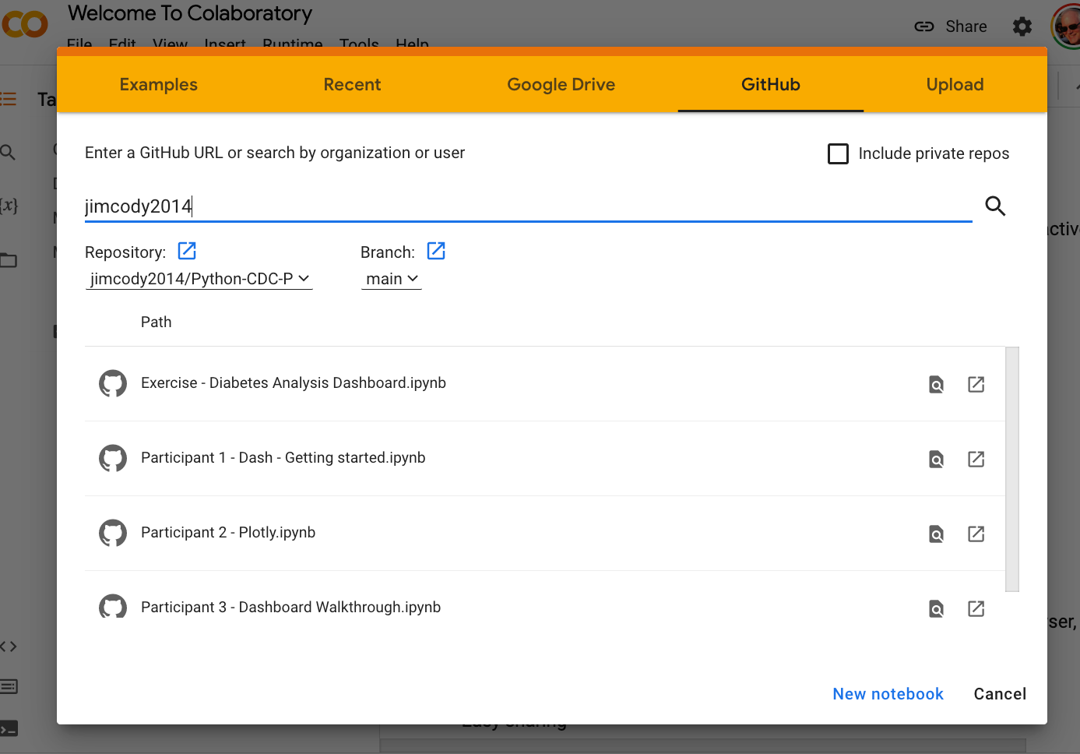
Morning Assignment – 20 minute exercise
In Google CoLab, open the notebook Exercise – Diabetes Analysis Dashboard
Create a copy using ‘Copy to Drive’
The notebook already has code to read in a csv file containing information about a diabetes study.
The data has been processed and grouped.
Create the code to build a dashboard app.
Include three plots. Use plotly express.
The categorical variables are:
year
month
admission_type_id
discharge_disposition_id
Please add a cell just before the dashboard cell. It needs to contain the install
!pip install jupyter_dash.
Get started when you are ready. We will review at 8:50am

Slide 18
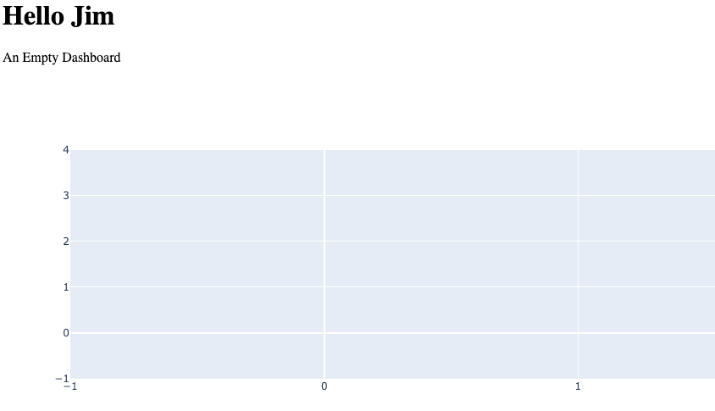
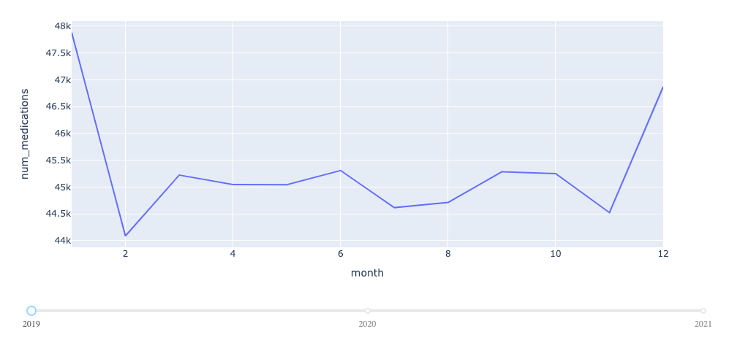
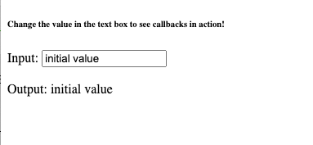
Notebooks
Interactivity Overview
Altair
Ipywidgets
Dashboard (8050)
2 – Dash (Outbreaks)
Explains components
Dashboard – no callback (8060)
Dashboard – callback (8071)
3 - Plotly
Px
go

Slide 19
Notebooks
Interactivity Overview
Altair
Ipywidgets
Dashboard (8050)
2 – Dash (Outbreaks)
Explains components
Dashboard – no callback (8060)
Dashboard – callback (8071)
3 - Plotly
Px
go

